Slide 1
Project by : VIVEK KUMAR VERMA
GAME DATA ANALYSIS
using SQL

Slide 2
AIM OF THE PROJECT
The aim of this project is to utilize SQL for analyzing game data to uncover insights into player behavior, game performance, and user engagement. This includes examining player activity patterns, assessing performance metrics, measuring user satisfaction, identifying trends, and generating actionable insights to enhance game design and strategy.

Slide 3
CONTENT
Project overview
Description of Data set
Data Exploration & Analysis

Slide 4
Project Overview
The dataset includes two tables: `Player Details` and `LevelDetails`. This project leverages SQL to analyze game data, aiming to uncover insights into player detail, game performance, and user engagement.
As a data analyst, I analyzed the Game Data to derive meaningful insights and present my findings.

Slide 5
Description of Each column in Dataset
Player Details Table:
• `P_ID`: Player ID
• `PName`: Player Name
• `L1_status`: Level 1 Status
• `L2_status`: Level 2 Status
• `L1_code`: Systemgenerated Level 1 Code
• `L2_code`: Systemgenerated Level 2 Code

Slide 6
Level Details Table:
• `P_ID`: Player ID
• `Dev_ID`: Device ID
• `start_time`: Start Time
• `stages_crossed`: Stages Crossed
• `level`: Game Level
• `difficulty`: Difficulty Level
• `kill_count`: Kill Count
• `headshots_count`: Headshots Count
• `score`: Player Score
• `lives_earned`: Extra Lives Earned

Slide 7
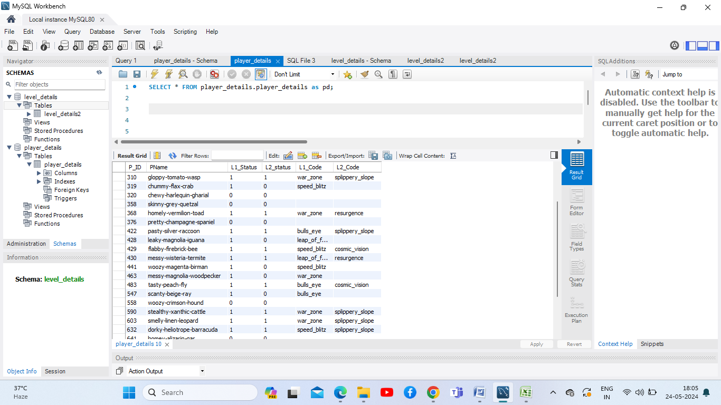
Data Set Description
Player table

Slide 8
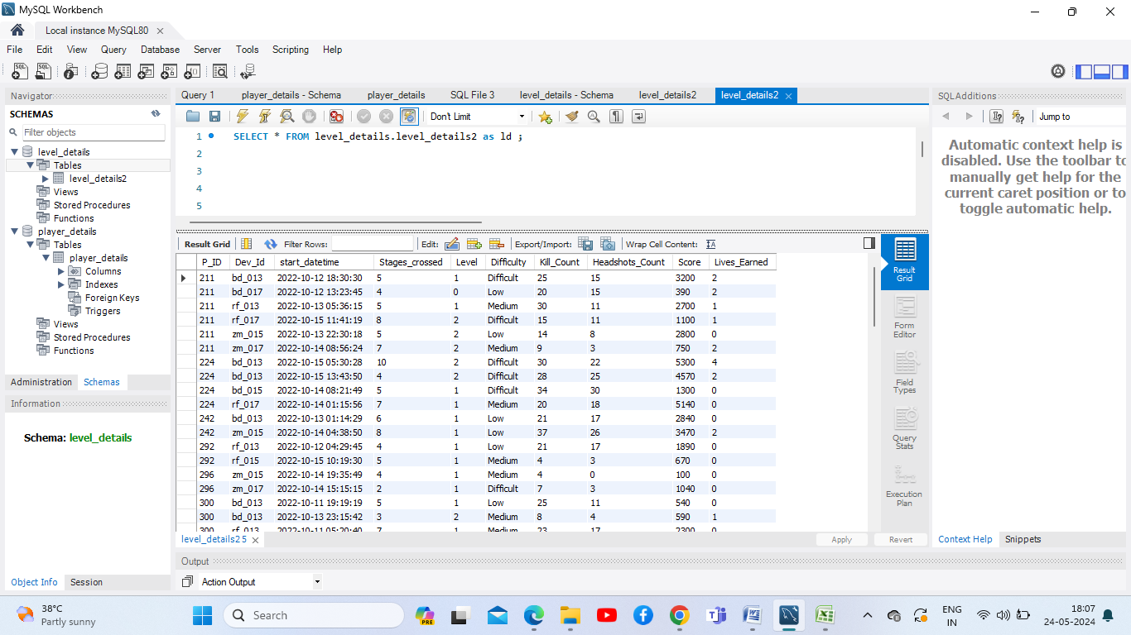
Level Table

Slide 9
Problem Statement
Game Analysis dataset
1) Players play a game divided into 3-levels (L0,L1 and L2)
2) Each level has 3 difficulty levels ( Low, Medium, High )
3) At each level, players have to kill the opponents using guns/physical fight
4) Each level has multiple stages at each difficulty level.
5) A player can only play L1 using its system generated L1_code.
6) Only players who have played Level1 can possibly play Level2 using its system generated L2_code.
7) By default a player can play L0.
8) Each player can login to the game using a Dev_ID.
9) Players can earn extra lives at each stage in a level.

Slide 10
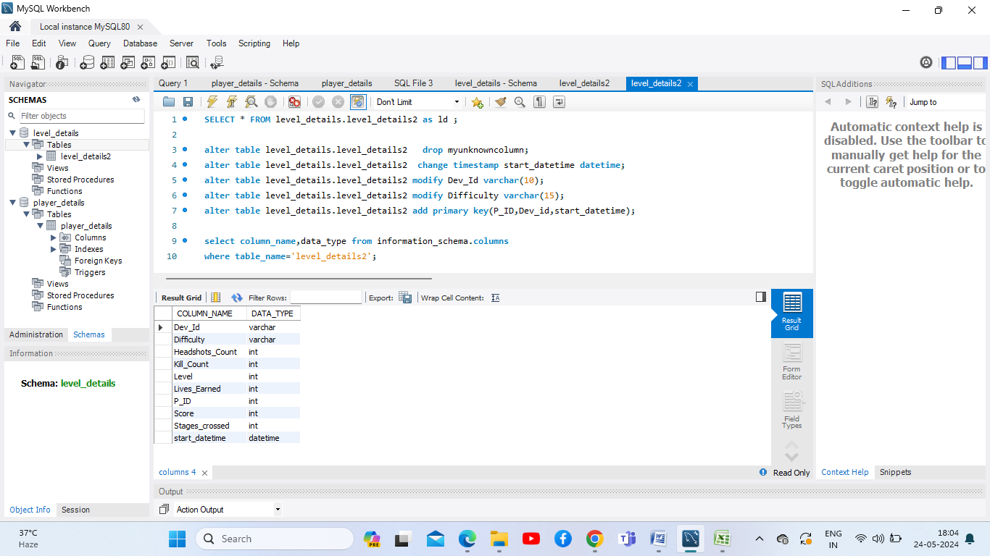
Data Exploration & Analysis
Change the Data type & constraint

Slide 11
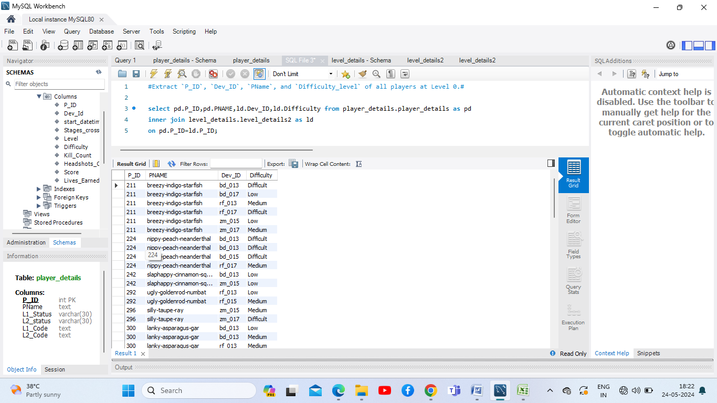
Extract `P_ID`, `Dev_ID`, `Pname`and`Difficulty_level` of all players.

Slide 12
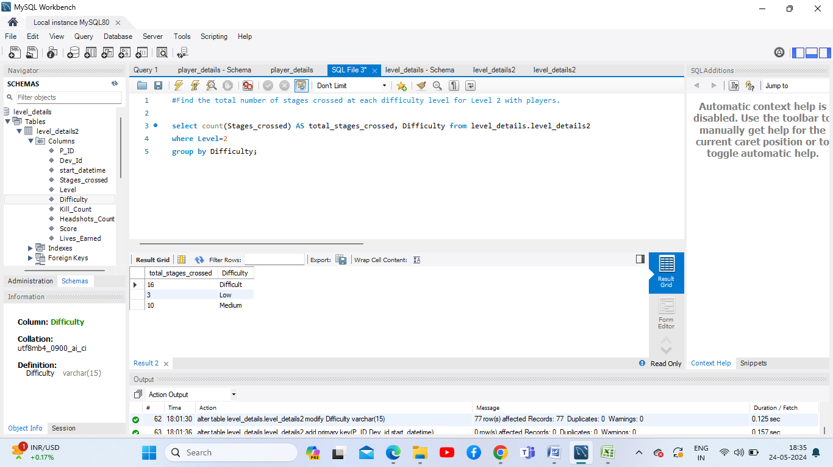
Total number of stages crossed at each difficulty level for Level 2 with players.

Slide 13
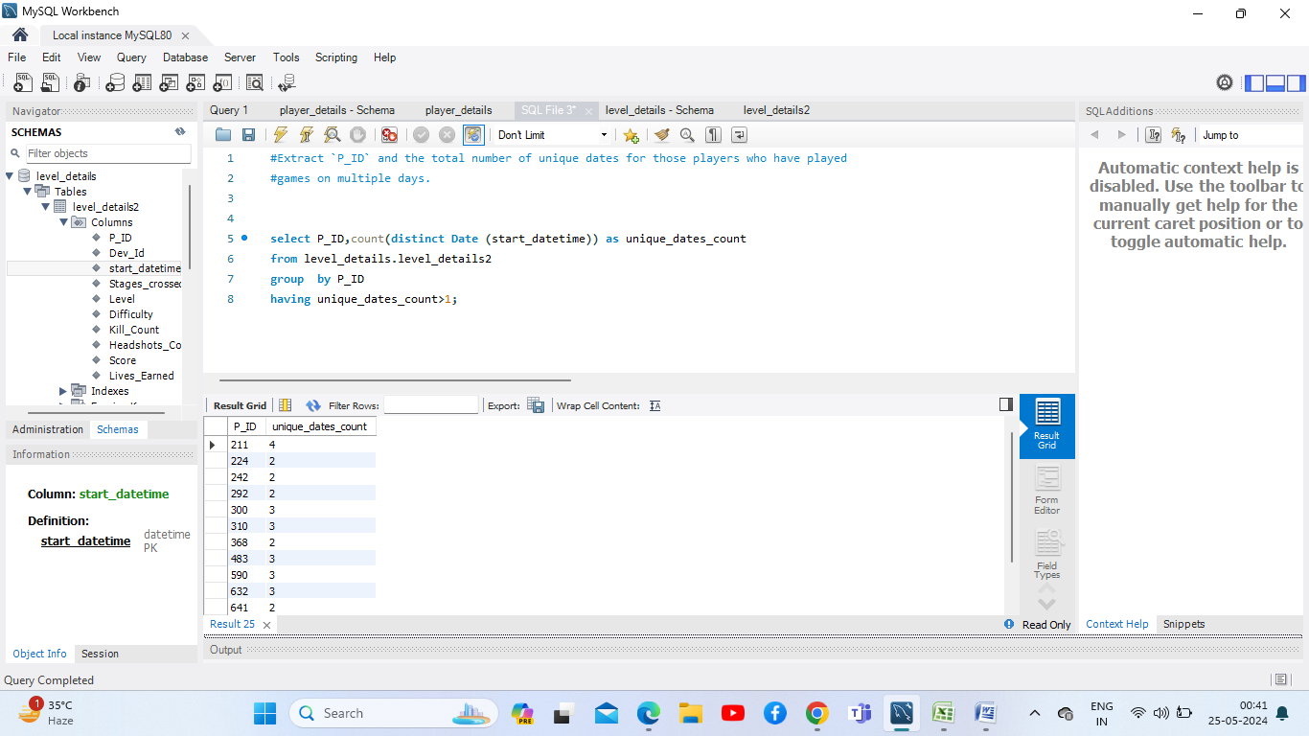
`P_ID` and the total number of unique dates for those players who have played games on multiple days.

Slide 14
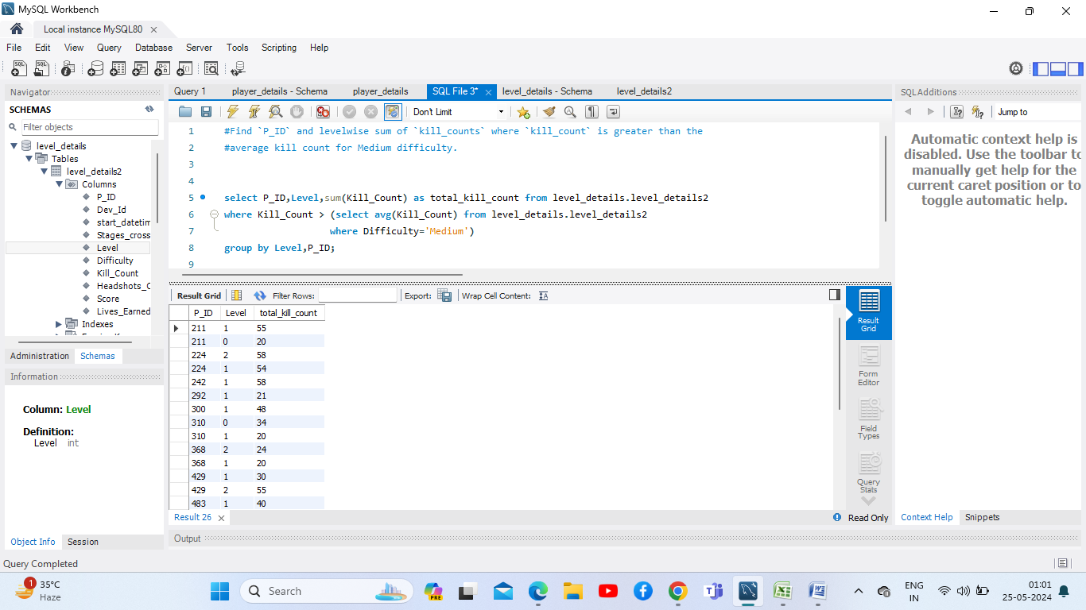
`P_ID` and level wise sum of `kill_counts` where `kill_count` is greater than the average kill count for Medium difficulty.

Slide 15
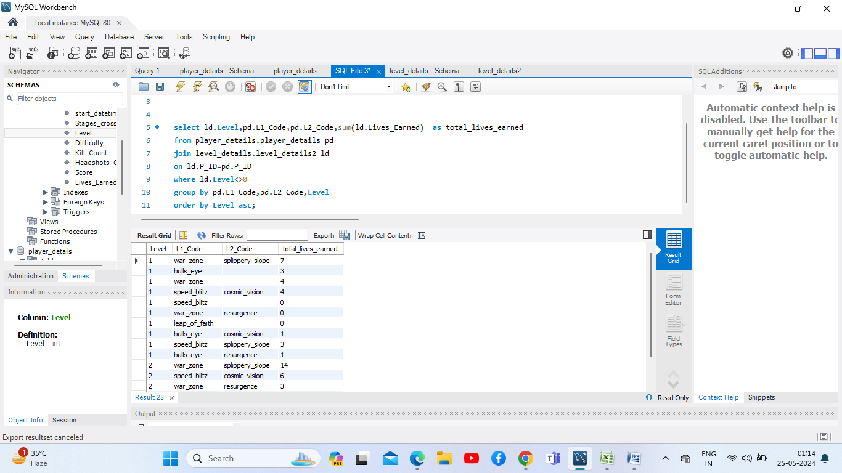
`Level` and its corresponding `Level_code`wise sum of lives earned, excluding Level 0. Arranging in ascending order of level.

Slide 16
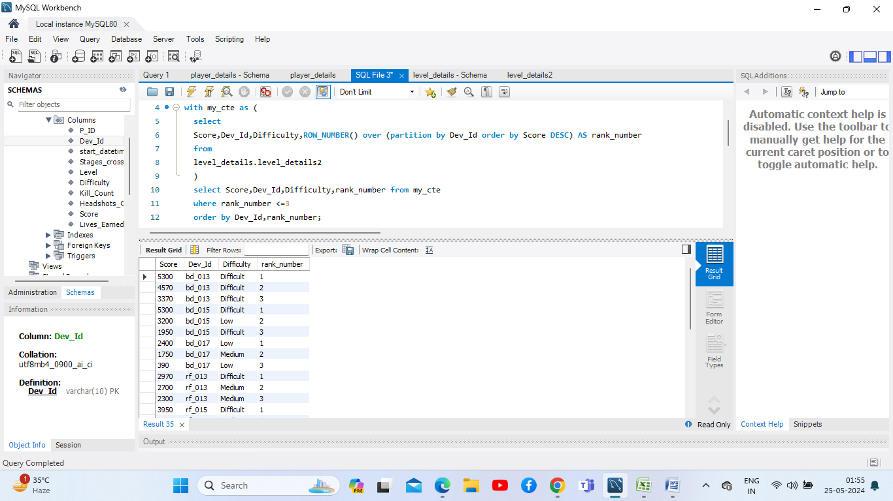
Top 3 scores based on each `Dev_ID` and rank them in increasing order using `Row_Number`. showing the difficulty as well.

Slide 17
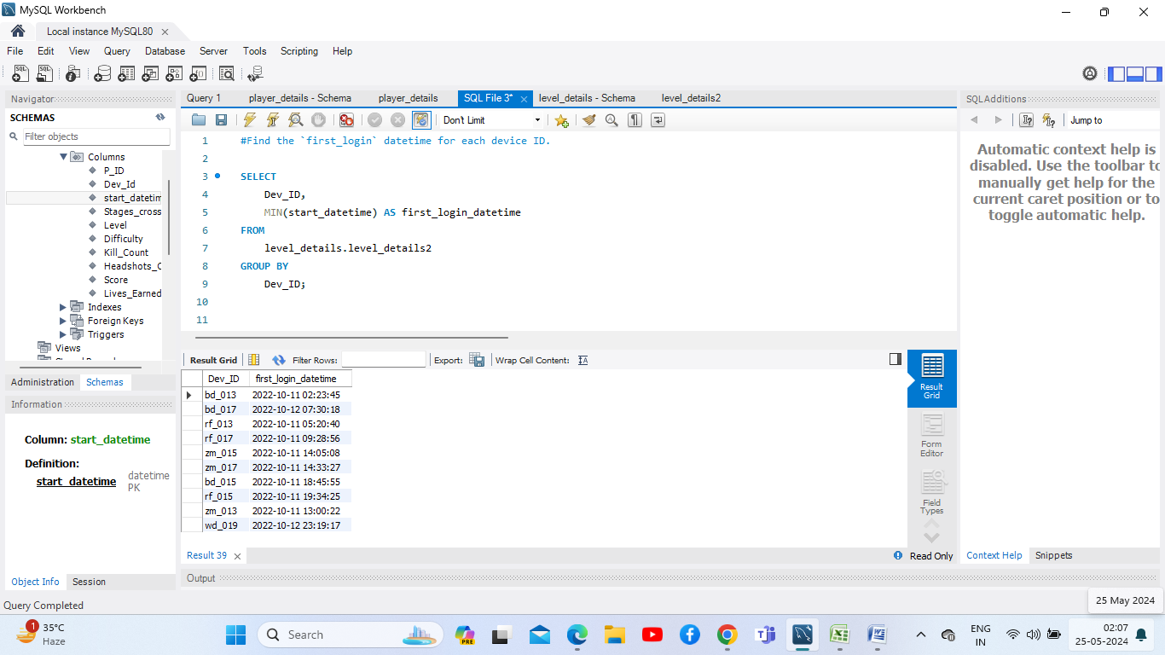
`first_login` datetime for each device ID.

Slide 18
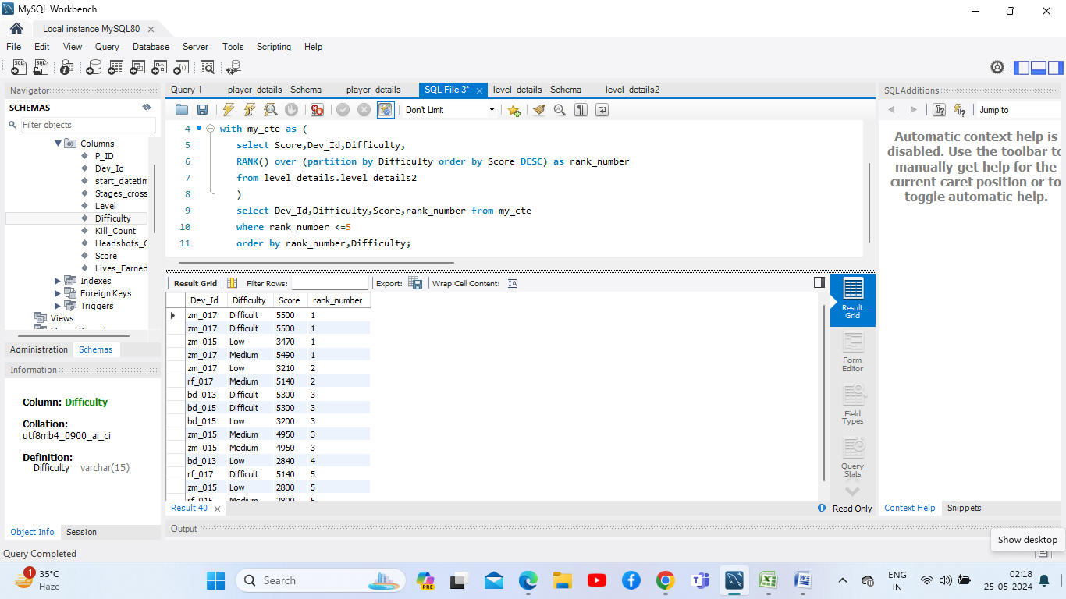
Top 5 scores based on each difficulty level and rank them in increasing order using `Rank`. Showing `Dev_ID` as well.

Slide 19
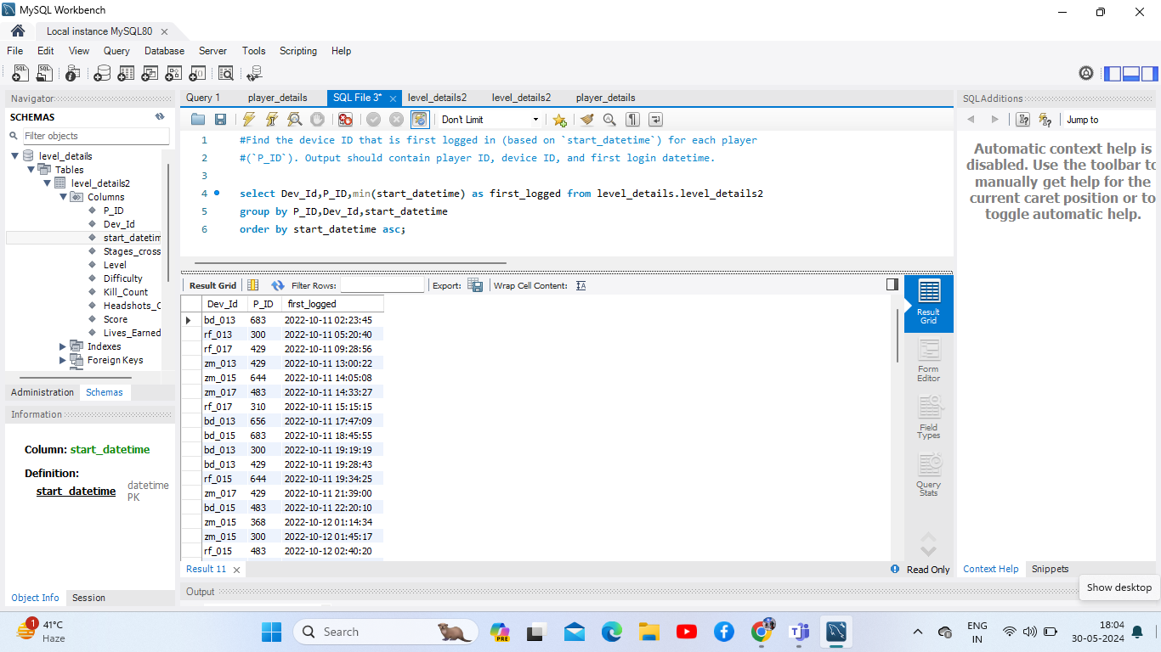
Device ID that is first logged in (based on`start_datetime`) for each player (`P_ID`). Output contain player ID, device ID, and first login datetime.

Slide 20
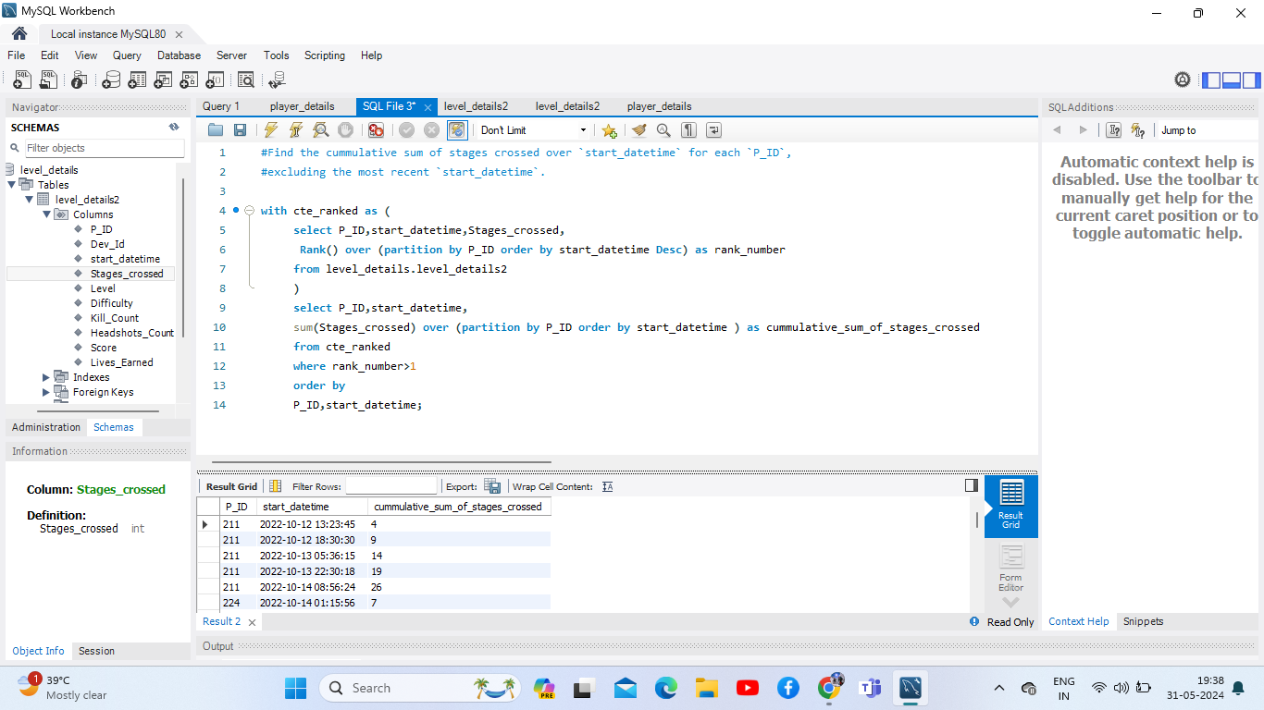
Cumulative sum of stages crossed over `start_datetime` for each `P_ID`,excluding the most recent `start_datetime`.

Slide 21
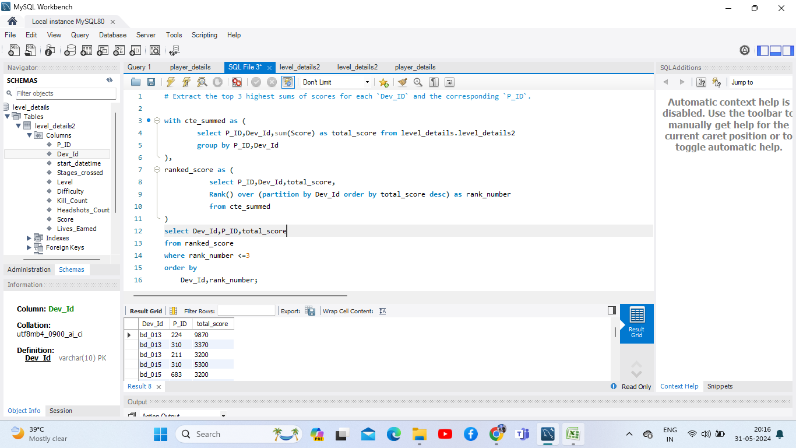
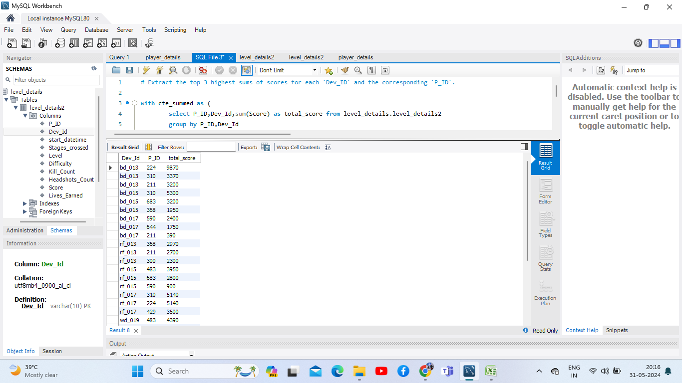
Extract the top 3 highest sums of scores for each `Dev_ID` and the corresponding`P_ID`.

